Slide 1
Second Year B. Tech. Advanced Data Structures (CS228)
By
Dr. Pramod D. Ganjewar
Senior Assistant Professor,
School of Computer Engineering,
MIT Academy of Engineering, Alandi(D.),Pune

Slide 2
Unit – 1 Trees Binary Trees Traversals

Slide 3
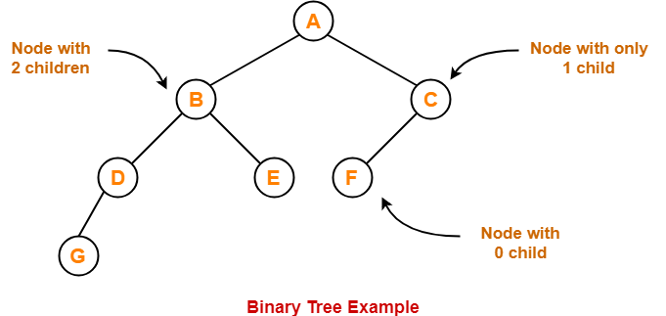
Binary Tree
Binary Tree
Binary tree is a special tree data structure in which each node can have at most 2 children.
Thus, in a binary tree, Each node has either 0 child or 1 child or 2 children.

Slide 4
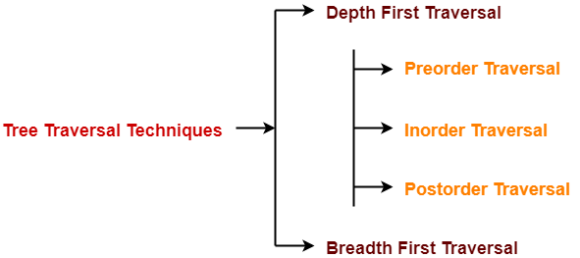
Binary Tree Traversals
Tree Traversal refers to the process of visiting each node in a tree data structure exactly once.
Various tree traversal techniques are –
Depth First Traversal
Preorder Traversal
In-order Traversal
Post-order Traversal
Breadth First Traversal

Slide 5
Depth First Traversals
Depth First Traversal-
Following three traversal techniques fall under Depth First Traversal-
Preorder Traversal
In-order Traversal
Post-order Traversal

Slide 6
Pre-Order Traversals
Algorithm-
Visit the root
Traverse the left sub tree i.e. call Preorder (left sub tree)
Traverse the right sub tree i.e. call Preorder (right sub tree)
Root → Left → Right

Slide 7
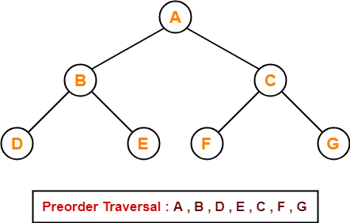
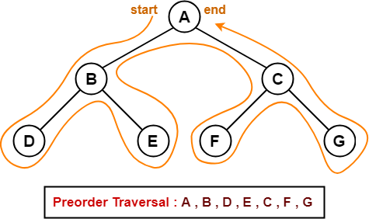
Pre-Order Traversals
Preorder Traversal Shortcut
Traverse the entire tree starting from the root node keeping yourself to the left.
Example
Consider the following example-

Slide 8
Pre-Order Traversals
Applications
Preorder traversal is used to get prefix expression of an expression tree.
Preorder traversal is used to create a copy of the tree.

Slide 9
In-Order Traversals
Algorithm-
Traverse the left sub tree i.e. call Inorder (left sub tree)
Visit the root
Traverse the right sub tree i.e. call Inorder (right sub tree)
Left → Root → Right

Slide 10
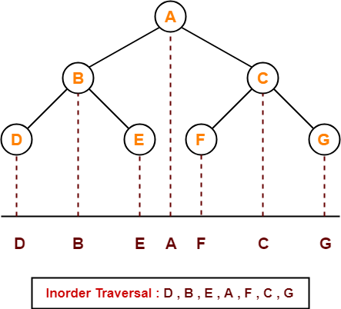
In-Order Traversals
In-order Traversal Shortcut
Keep a plane mirror horizontally at the bottom of the tree and take the projection of all the nodes.
Example
Consider the following example-

Slide 11
In-Order Traversals
Applications
In-order traversal is used to get infix expression of an expression tree.

Slide 12
Post-Order Traversals
Algorithm-
Traverse the left sub tree i.e. call Postorder (left sub tree)
Traverse the right sub tree i.e. call Postorder (right sub tree)
Visit the root
Left → Right → Root

Slide 13
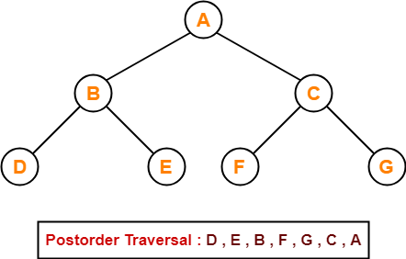
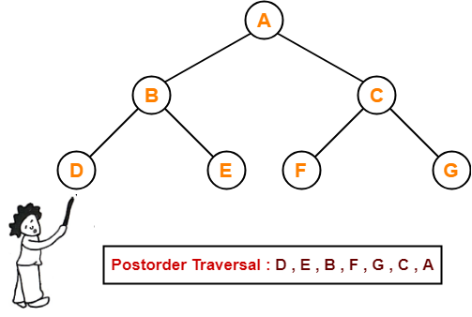
Post-Order Traversals
Post-order Traversal Shortcut
Pick all the leftmost leaf nodes one by one.
Example
Consider the following example-

Slide 14
Post-Order Traversals
Applications
Post-order traversal is used to get postfix expression of an expression tree.
Post-order traversal is used to delete the tree. This is because it deletes the children first and then it deletes the parent.

Slide 15
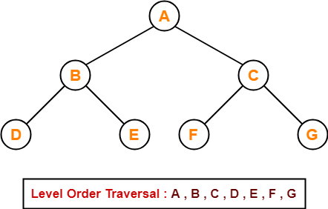
Breadth First Traversals
Breadth First Traversal of a tree prints all the nodes of a tree level by level.
Breadth First Traversal is also called as Level Order Traversal.
Example - Consider the following example-

Slide 16
Breadth First Traversals
Applications
Level order traversal is used to print the data in the same order as stored in the array representation of a complete binary tree.

Slide 17
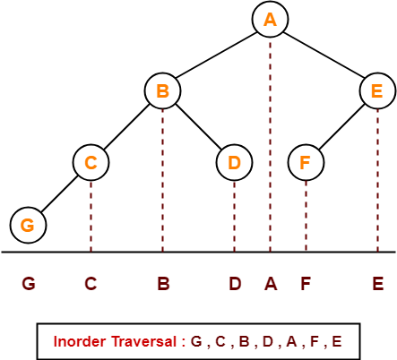
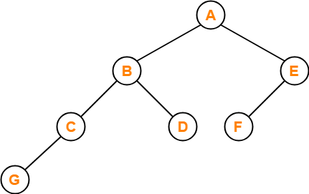
Problems on Tree Traversals
Problem – 1
If the binary tree in figure is traversed in inorder, then the order in which the nodes will be visited is ____?
Solution-
The inorder traversal will be performed as-

Slide 18
Problems on Tree Traversals
Problem – 2
Which of the following sequences denotes the post-order traversal sequence of the tree shown in figure?
1. FEGCBDBA
2. GCBDAFE
3. GCDBFEA
4. FDEGCBA
Solution-
Perform the post-order traversal by plucking all the leftmost leaf nodes one by one.
Then, Postorder Traversal is as follows
G , C , D , B , F , E , A
Thus, Option (3) is correct.

Slide 19
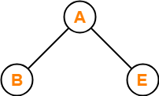
Problems on Tree Traversals
Problem – 3
Let LASTPOST, LASTIN, LASTPRE denote the last vertex visited in a post-order, in-order and preorder traversal respectively of a complete binary tree. Which of the following is always true?
1. LASTIN = LASTPOST
2. LASTIN = LASTPRE
3. LASTPRE = LASTPOST
4. None of these
Solution
Consider the following complete binary tree-
Pre-order Traversal : B , A , E
In-order Traversal : B , A , E
Post-order Traversal : B , E , A
Clearly, LASTIN = LASTPRE.
Thus, Option (2) is correct.

Slide 20
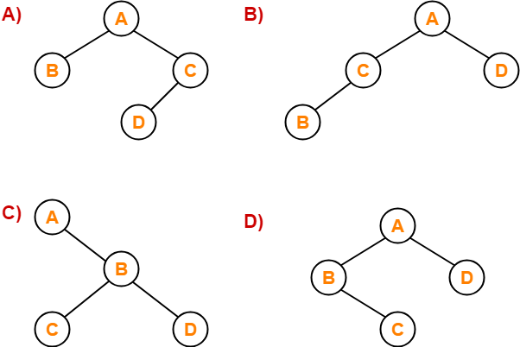
Problems on Tree Traversals
Problem – 4
Which of the following binary trees has its in-order and preorder traversals as BCAD and ABCD respectively-
Solution
Option (D) is correct

Slide 21
Thank You

